Slide 1
AUTOMATIC BUS ROUTES
SELECTION USING
MACHINE LEARNING TECHNIQUES
Review-0
TEAM MEMBERS:-
V SaI Amruth(180330286)
N Sudheer Reddy(180330154)
B sai charan(180330248)
Team Supervisor:
Ms Madhu Priya

Slide 2
Abstract
This project helps the new business people who are ready to start their local buses transportation in metropolitan cities and it also helps the existing local buses transportation to run their buses in minimal locations to avoid losses

Slide 3

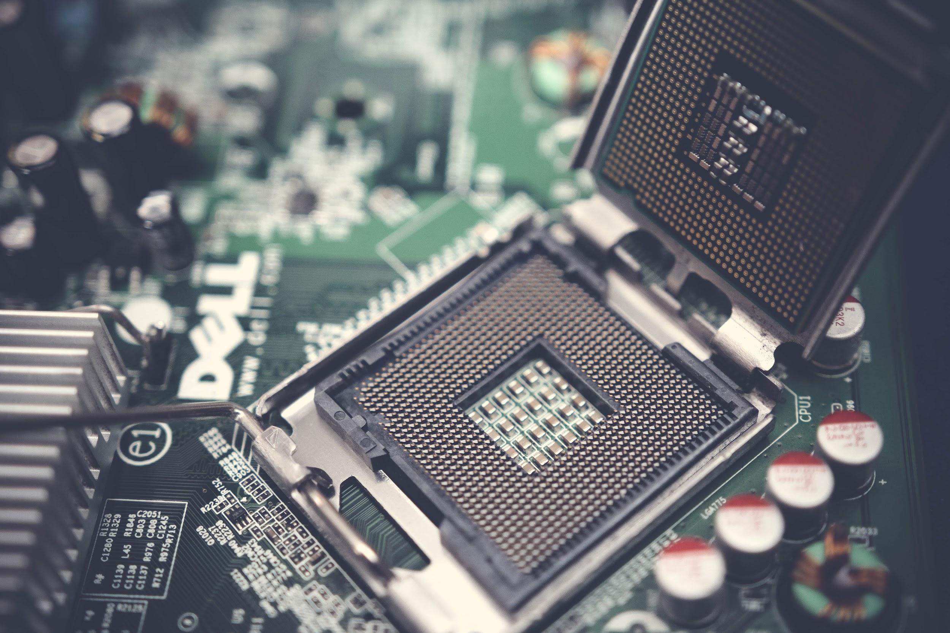
Software and Hardware requirements
Hardware:
.Processor: AMD Ryzen 5 4500U with Radeon Graphics 2.38 GHz
.RAM:8.00 GB
.Operating System: Windows 11
.64-bit operating system, x64-based processor
Software:
.Python 3.8 And Packages
.Google colab
.Google forms
.Pycharm,Git

Slide 4
Functional Requirements
After developing this application Manager should be able to access their system such that he should know the bus can run or not in the path
Tracker Application. Calculations required for this application are all related to past data & Data processing is done by using different python libraries like pandas

Slide 5
Non - Functional Requirements
Maintainability
Reliability
Extensibility
Portability

Slide 6
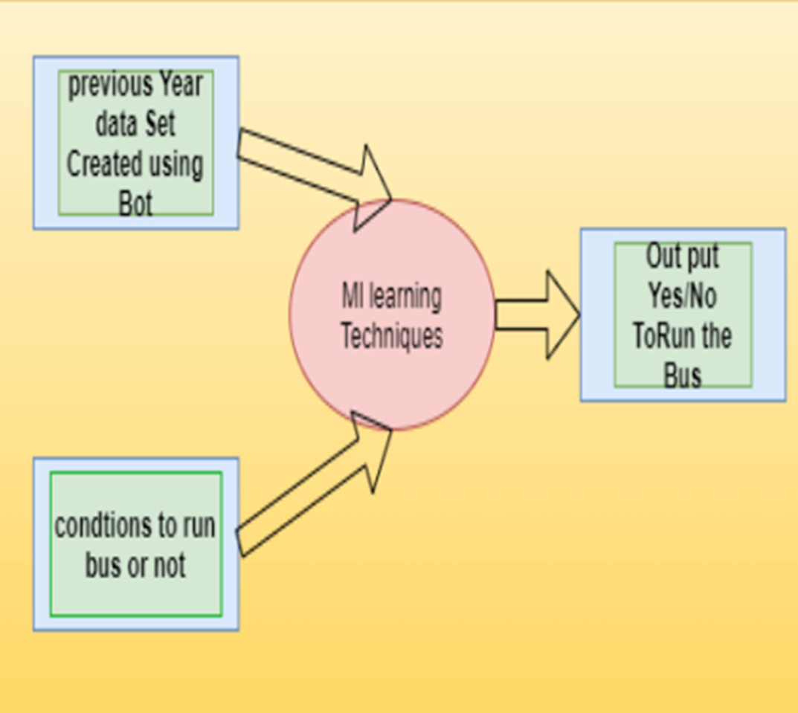
Design :

Slide 7


